Slide 1

Basic Inorganic Chemistry For B.Tech & B.Sc I yr
Main Group Chemistry
(2 lectures)
Silicones, silicates, aluminosilicates, zeolites and shape selective catalysis
Prepared by Prof. Anil J. Elias, IIT Delhi

Slide 2
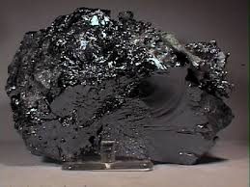
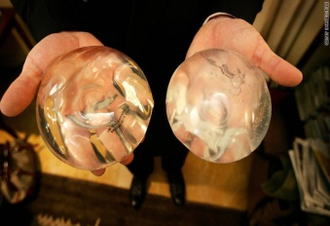
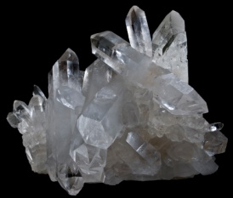
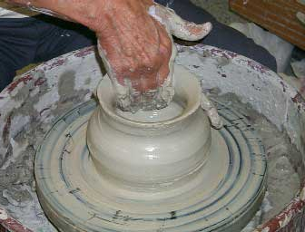
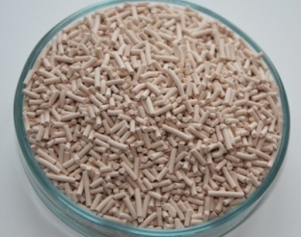

Silicon, Silicone, Silicate, Aluminosilicate, Zeolites
and Shape Selective Catalysis
What makes silicon unique and its chemistry the choice of a wide range of environmentally friendly industrial applications ?
High natural abundance and easy availability of starting material (Sand) (silicon is the second most abundant element on the earth)
An easy purification process to pure silicon
A simple and cost efficient method for synthesis of organochlorosilanes and their polymerization to silicone polymers
Highly environmentally friendly end products with a diverse range of proven applications
Applications in steel refining & Semiconductor industry
Inorganic polymer industry based on Silicones
Industry based on piezo electricity of quartz
Industry based on alumino silicates: from bricks, glass, cement to crockery
Zeolites as drying agents water softeners and unique catalysts
Taken from the earth : given back to the earth

Slide 3
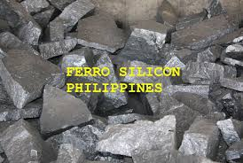
Isolation and Purification of the Element
The first step in making pure silicon is reduction of silica to an impure form of silicon known as ferrosilicon. Ferrosilicon is an iron-silicon alloy that contains varying ratios of elemental silicon and iron.
Ferrosilicon accounts for about 80% of the world's production of elemental silicon. Silicon has a high propensity to form bonds with oxygen and Ferrosilicon is primarily used by the steel industry to remove dissolved oxygen in steel melt.
Ultrapure silicon for solar cells and electronics
For solar cell fabrication one requires silicon of much higher purity (+99.9%). For electronics grade the purity required is even higher (99.9999999% ; known as 9 nines)

Slide 4
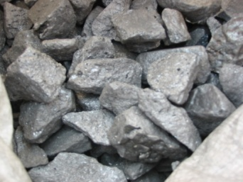
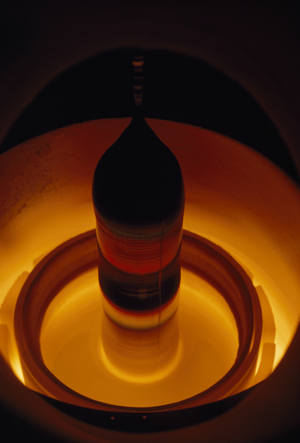
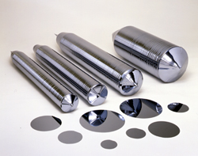
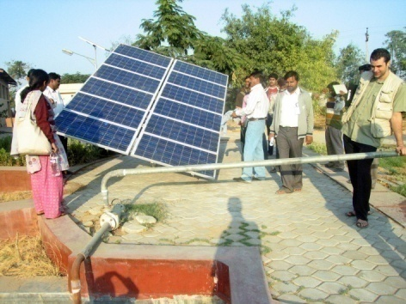
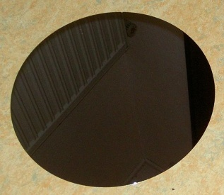
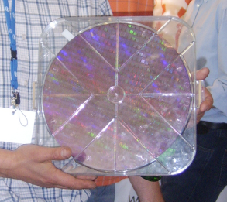
How is ultrapure silicon made and processed ?

Slide 5
Carbon versus
Silicon-
Bond Energies

Slide 6
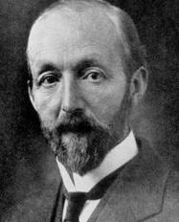

Silicone Polymers
Kipping coined the word silicone. In 1937, after 30 years of research, on the occasion of his retirement (Bakrerian lecture of the Royal Society) said “The prospect of any immediate and important advance in this section of organic chemistry does not seem to be very hopeful." In 1943 Dow Corning company took up industrial production of silicone polymers
Lowest glass transition temperature, Tg = -127 °C

Slide 7
Early synthesis of organosilanes
First report 1863 Friedel and Craft using alkylzinc reagents
SiCl₄ + m/2 ZnR₂ → R_{m}SiCl_{4-m} + m/2 ZnCl₂
F. Stanley Kipping used first organozinc, followed by Wurtz coupling (Na) and later Grignard reagents to make organosilicon compounds.
In 57 research papers Kipping created the basis of organosilicon chemistry. He made mostly ethyl and phenyl organochlorosilanes as methyl chloride is a gas difficult to handle. First examples of silicone polymers (having ethyl and or phenyl groups) was reported by Kipping in 1904 and he described the products of his reaction as “sticky messes of no particular use!”

Slide 8

The Direct synthesis: Rochow-Mueller Process (1940)
The economically viable alternative for Grignard method:
Modern synthesis of organochlorosilanes

Slide 9
Polydimethylsilicone (PDMS)
Industrial synthetic routes

Slide 10
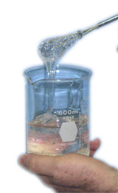

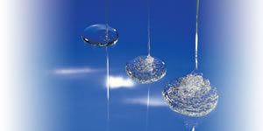
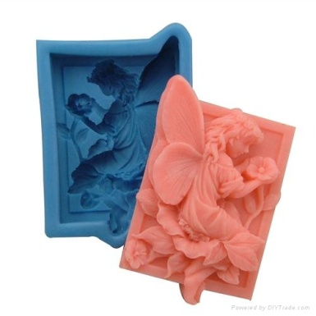
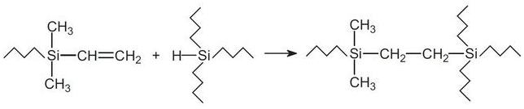
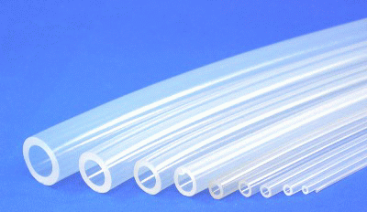
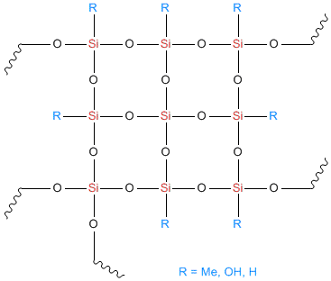

Types of silicone polymers
Silicone fluids: Linear chain silicones with varying substituents on silicon
Silicone rubbers or elastomers: Crosslinked silicone fluids with or without a filler
Silicone resins: Highly branched

Slide 11
Silicone fluids
Property Application
High thermal stability Heat transfer media
Good low temp performance refrigerant in cryostats
Low surface tension release agents
antifoams
antiflatulents
Water repellency water proofing, polishes
waterproof textiles
Antifriction lubricant
Good dielectric properties power transmission fluids
High oxygen permeability masks, contact lens
Non toxicity medical
Tolerance to skin and physiological cosmetics, ointments

Slide 12
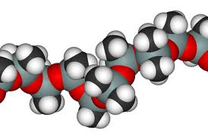
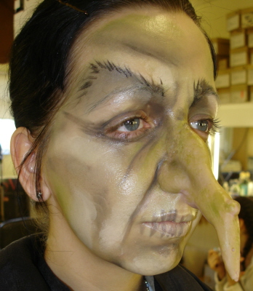
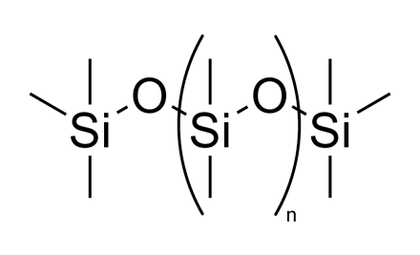
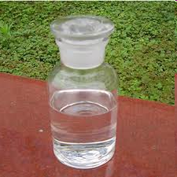
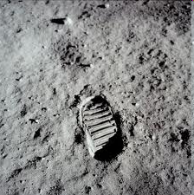
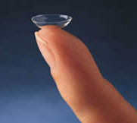
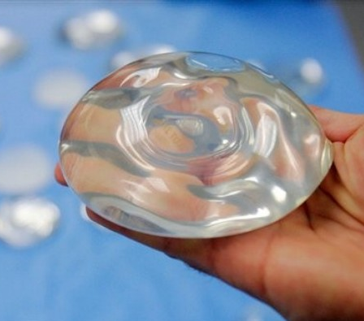
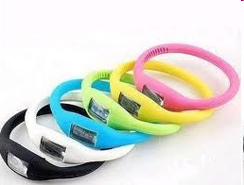
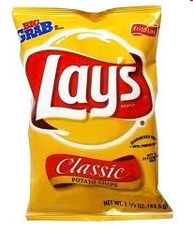
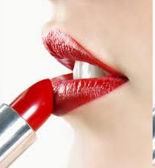

Industrial success of Silicones
Hydrophobicity Oxygen permeability
Wide temp range Low glass transition temp
Antifrothing Non toxicity
First human foot print on moon
Moon temperature
(-153 to +107 °C)

Slide 13
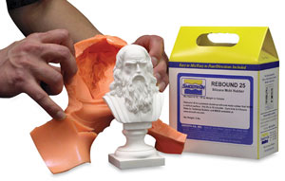
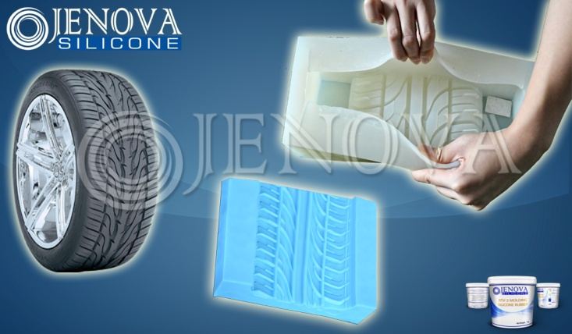
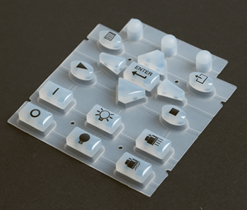

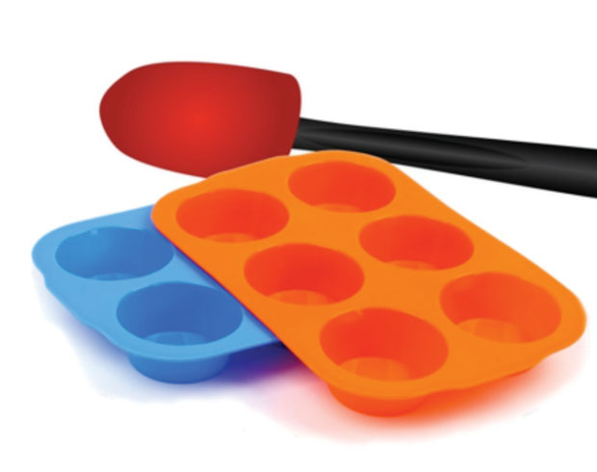
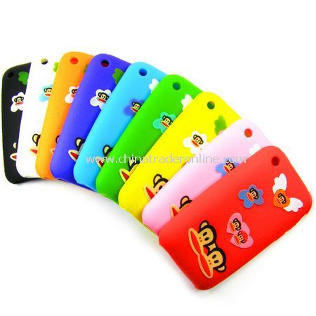
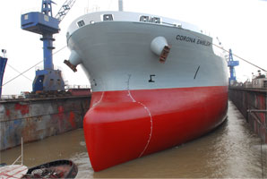
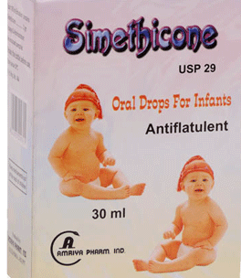
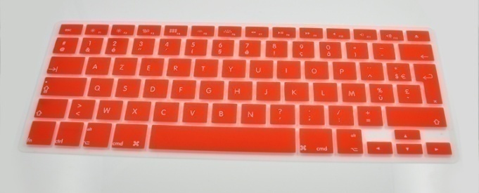

Slide 14
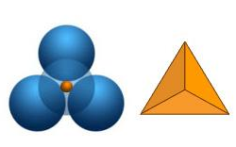
The chemistry of silicates and aluminosilicates
The representation of tetrahedral silicates

Slide 15
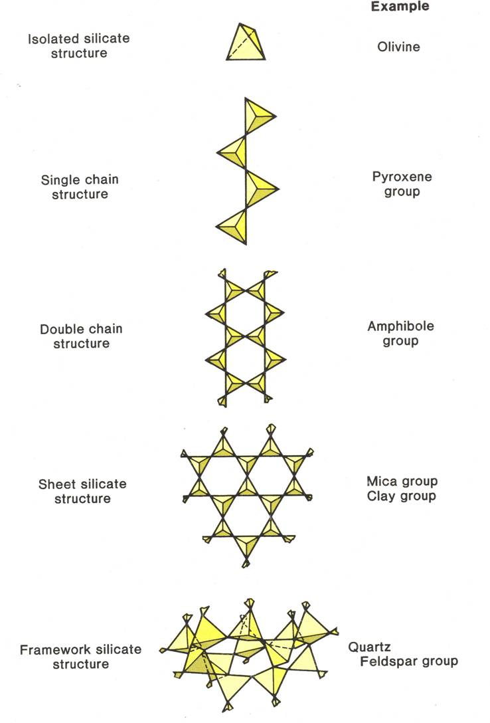
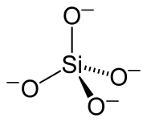
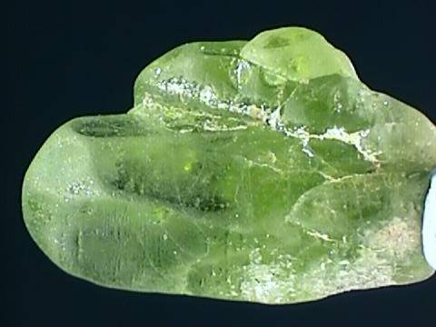
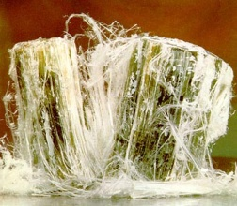
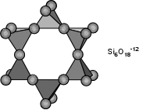
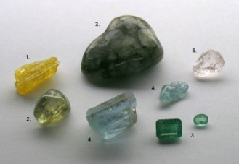
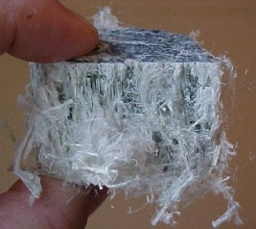
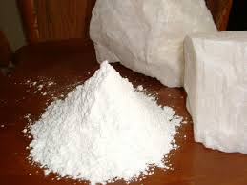
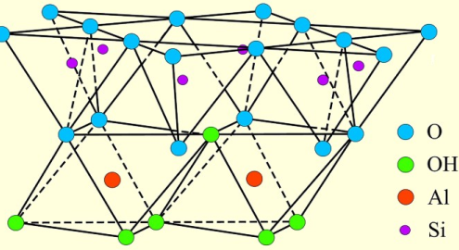
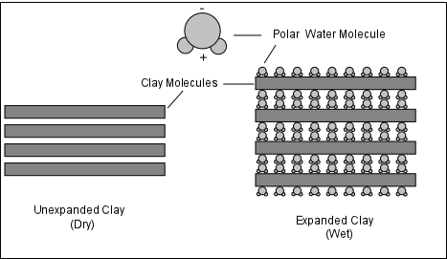
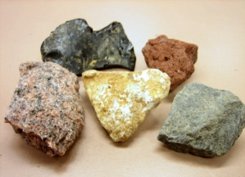

(Mg, Fe)₂SiO₄
Be₃Al₂(SiO₃)₆.
asbestos
Mg₃Si₄O₁₀(OH)₂.
aluminosilicates

Slide 16
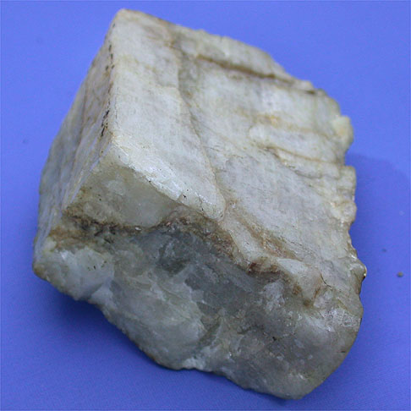


Three different forms of tecto silicates (framework silicates) 4 O shared
Pure silicate: quartz, vitreous silica, silica gel, Fumed silica
Aluminosilicates; (having tetrahedral Al replacing tetrahedral Si)
Feldspars Ultramarines Zeolites
Sodalite cage
Na₈S₂(Al₆Si₆O₂₄)
Linde A ( Mol sieves 4A)
Na₆(Al₆Si₆O₂₄). 2H₂0
Igneous rocks
K(AlSi₃O₈)
Blue due to S₃⁻ radical anion

Slide 17




Zeolites or Molecular Sieves
Are porus solids
Have replaceable Na+ cations
Have channels which lead to cavities
Have water molecules in these cavities and channels
The channel and cavity size vary from zeolite to zeolite

Slide 18
imbalance

Slide 19

Zeolite Structure: Framework Alumino silicates
When a tetrahedral silicon (IV) is replaced in a silicate by an tetrahedral aluminum(III), the framework attains an extra negative charge. This will be compensated by a cation such as Na+. Such compounds are termed framework aluminosilicates

Slide 21




Platonic Solids
423 BC 347 BC
Archimedian Solids

Slide 22



3 Dimensional Perspective of Zeolites:
Truncating an Octahedron !
Octahedron
Truncated Octahedron

Slide 23




Also known as β cage
8 hexagons and 6 squares
Lowenstein’s Rule:
The AlO₄⁻ tetrahedra are always interspersed with SiO₄ tetrahedra
Or
Al-O-Al units does not occur in zeolites
The inside cavity is known as α cage having 6 octagons
8 hexagons and 12 squares

Slide 24




STRUCTURE OF ZEOLITES
β cages – directly linked through square faces = Sodalite
β cages – linked through square faces but with a D4R spacer = Linde A
β cages – linked through hexagonal faces but with a D6R spacer = Faujasite
Sodalite Linde A Faujasite
not considered a zeolite (Molecular Sieves 4A)

Slide 25



ZSM-5: Zeolite Socony Mobil–5
is a zeolite belonging to the pentasil family of zeolites. Its chemical formula is Na₃Al₃Si₉₃O₁₉₂·16H₂O. Patented by Mobil Oil Company in 1975, it is widely used in the petroleum industry as a heterogeneous
catalyst for hydrocarbon isomerization reactions.
ZSM-5 has a high silicon to aluminum ratio.
Most well known zeolite catalyst
5.1 x5.5 Å
Channel size 5.4 x 5.6 Å
Al: Si ratio 1:31

Slide 26



Zeolite A or Linde-A
Channel size 4.1 Å
Al: Si ratio 1:1
Na₁₂(AlO₂)₁₂(SiO₂)₁₂. 27 H₂O
Used as an ion exchanger for water softening (in detergents) due to high Na+ content. Dehydrated form used for absorption of moisture and small volatile molecules. Reusable and environmentally safe
Zeolite Y or Faujasite
Channel size 7.4 Å
Na₂(AlO₂)₂(SiO₂)₅. 10 H₂O
Al: Si ratio 2:5
Catalysis of larger molecules. Metal complexes can be even made inside the cavities

Slide 27






Si 50% - Al 50%
Cations Na, Ca
Polar
3-D straight channels
Linde A
Ring 8
Si 93 %
non-polar
Hydrophobic
1-D channels
ZSM 5
Ring 10
Si x% - Al y%
Cations Na, Ca
Polar
3-D entangled channels
Faujasite
Ring 12

Slide 28
ZSM-5: Shape Selectivity in Catalysis

Slide 29

Transition State Shape Selectivity,
some transition-state intermediates are too large to be accommodated within the pores/cavities of the zeolites, even though
diffusion of neither the reactants nor the products are restricted.
transalkylation of dialkylbenzenes
meta-xylene, 1,3,5- and 1,2,4-trialkylbenzene.

Slide 30


ZSM-5 catalyst

Slide 31

SHAPE SELECTIVE CATALYSIS - REACTANT, PRODUCT, TRANSITION STATE SELECTIVITY

